Slide 1
The RCA Computron
A 14 bit by 14 bit digital multiplier…
in a single electron tube.
Y = (A * X) + B + C

Slide 2
Earliest available documents show the project began in the Summer of 1941, by principal investigators:
Richard L. Snyder, Jr.,
Jan Rajchman
Paul Rudnick

Slide 3
Gun Directors
Mechanical marvels intended to aim artillery at incoming aircraft.
Operated by teams of skilled operators
Marginally better than dead reckoning.

Slide 4
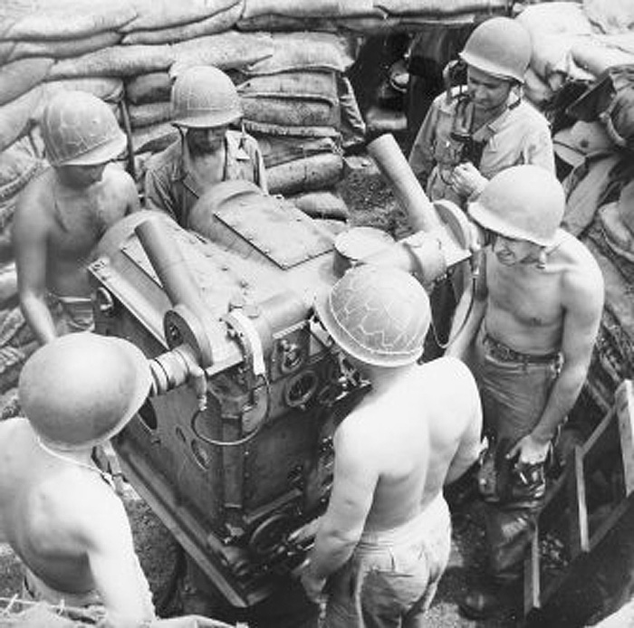
M7 Director

Slide 5
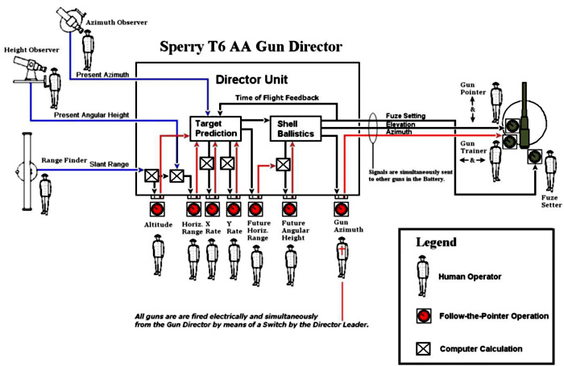

Slide 6
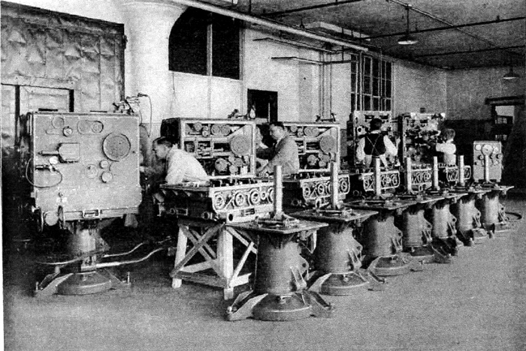

Slide 7
Decimal Multiplication
2 9 7 Multiplicand
x 1 8 9 Multiplier
2 6 7 3 Partial product of 9 times 279
2 3 7 6 Partial product of 80 times 279
2 9 7 Partial product of 100 times 279
1 2 1 0 0 Carry (addition of partial products)
5 6 1 3 3 Sum

Slide 8
2 9 7 Multiplicand x 0 0 9 Multiplier 2 6 7 3 Partial product 0 0 0 0 Sum in 0 0 0 0 Carry (generated during addition) 2 6 7 3 Intermediate Sum out 2 9 7 Multiplicand x 0 8 0 Multiplier 2 3 7 6 0 Partial product 2 6 7 3 Sum in 0 1 1 0 0 Carry (generated during addition) 2 6 4 3 3 Intermediate Sum out 2 9 7 Multiplicand x 1 0 0 Multiplier 2 9 7 Partial product 2 6 4 3 3 Sum in 1 1 0 0 0 Carry (generated during addition) 5 6 1 3 3 Final Sum out

Slide 9
Binary Addition
0 plus 0 equals 0
0 plus 1 equals 1
1 plus 0 equals 1
1 plus 1 equals 0 with a carry

Slide 10
Binary Multiplication
0 times 0 equals 0
0 times 1 equals 0
1 times 0 equals 0
1 times 1 equals 1

Slide 11
Thus, multiplying 10111 by 1110 in binary notation: 1 0 1 1 1 Multiplicand x 1 1 1 0 Multiplier 0 0 0 0 0 partial product 1 0 1 1 1 partial product 1 0 1 1 1 partial product 1 0 1 1 1 partial product 1 2 2 2 1 0 0 0 Carry (generated during addition) 1 0 1 0 0 0 0 1 0 sum The rules are simple: If the digit of the multiplier is 0, add nothing; if it is 1, add the shifted multiplicand to that of the digit.

Slide 12
1 0 1 1 1 Multiplicand x 1 1 1 0 Multiplier 1 0 1 1 1 Multiplicand x 0 0 0 0 Multiplier 0 0 0 0 0 partial product 0 0 0 0 0 sum in 0 0 0 0 0 Carry (generated during addition) 0 0 0 0 0 sum out 1 0 1 1 1 Multiplicand x 0 0 1 0 Multiplier 1 0 1 1 1 partial product 0 0 0 0 0 sum in 0 0 0 0 0 0 Carry (generated during addition) 1 0 1 1 1 0 sum out 1 0 1 1 1 Multiplicand x 0 1 0 0 Multiplier 1 0 1 1 1 partial product 1 0 1 1 1 0 sum in 1 1 1 1 1 0 0 0 Carry (generated during addition) 1 0 0 0 1 0 1 0 sum out 1 0 1 1 1 Multiplicand x 1 0 0 0 Multiplier 1 0 1 1 1 partial product 1 0 0 0 1 0 1 0 sum in 1 0 1 1 1 0 0 0 0 Carry (generated during addition) 1 0 1 0 0 0 0 1 0 sum out

Slide 13
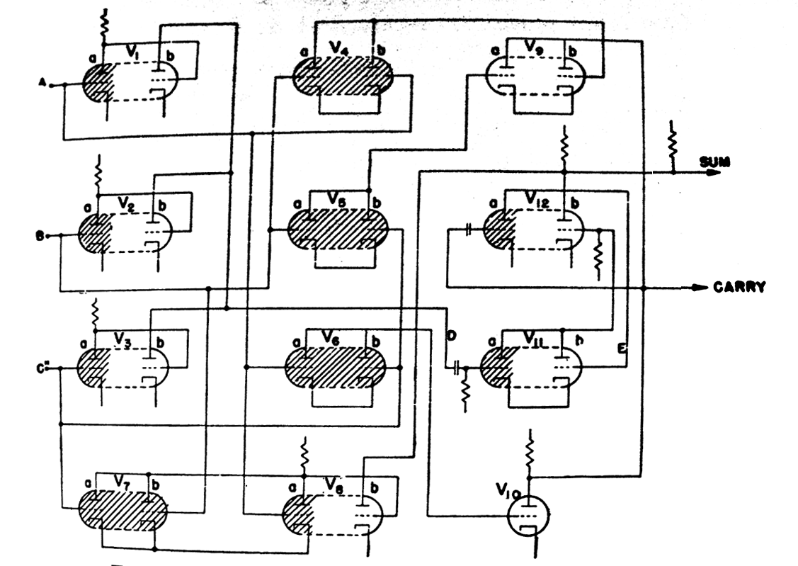
3-Bit Adder

Slide 14
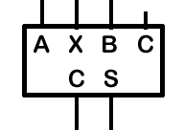

Slide 15
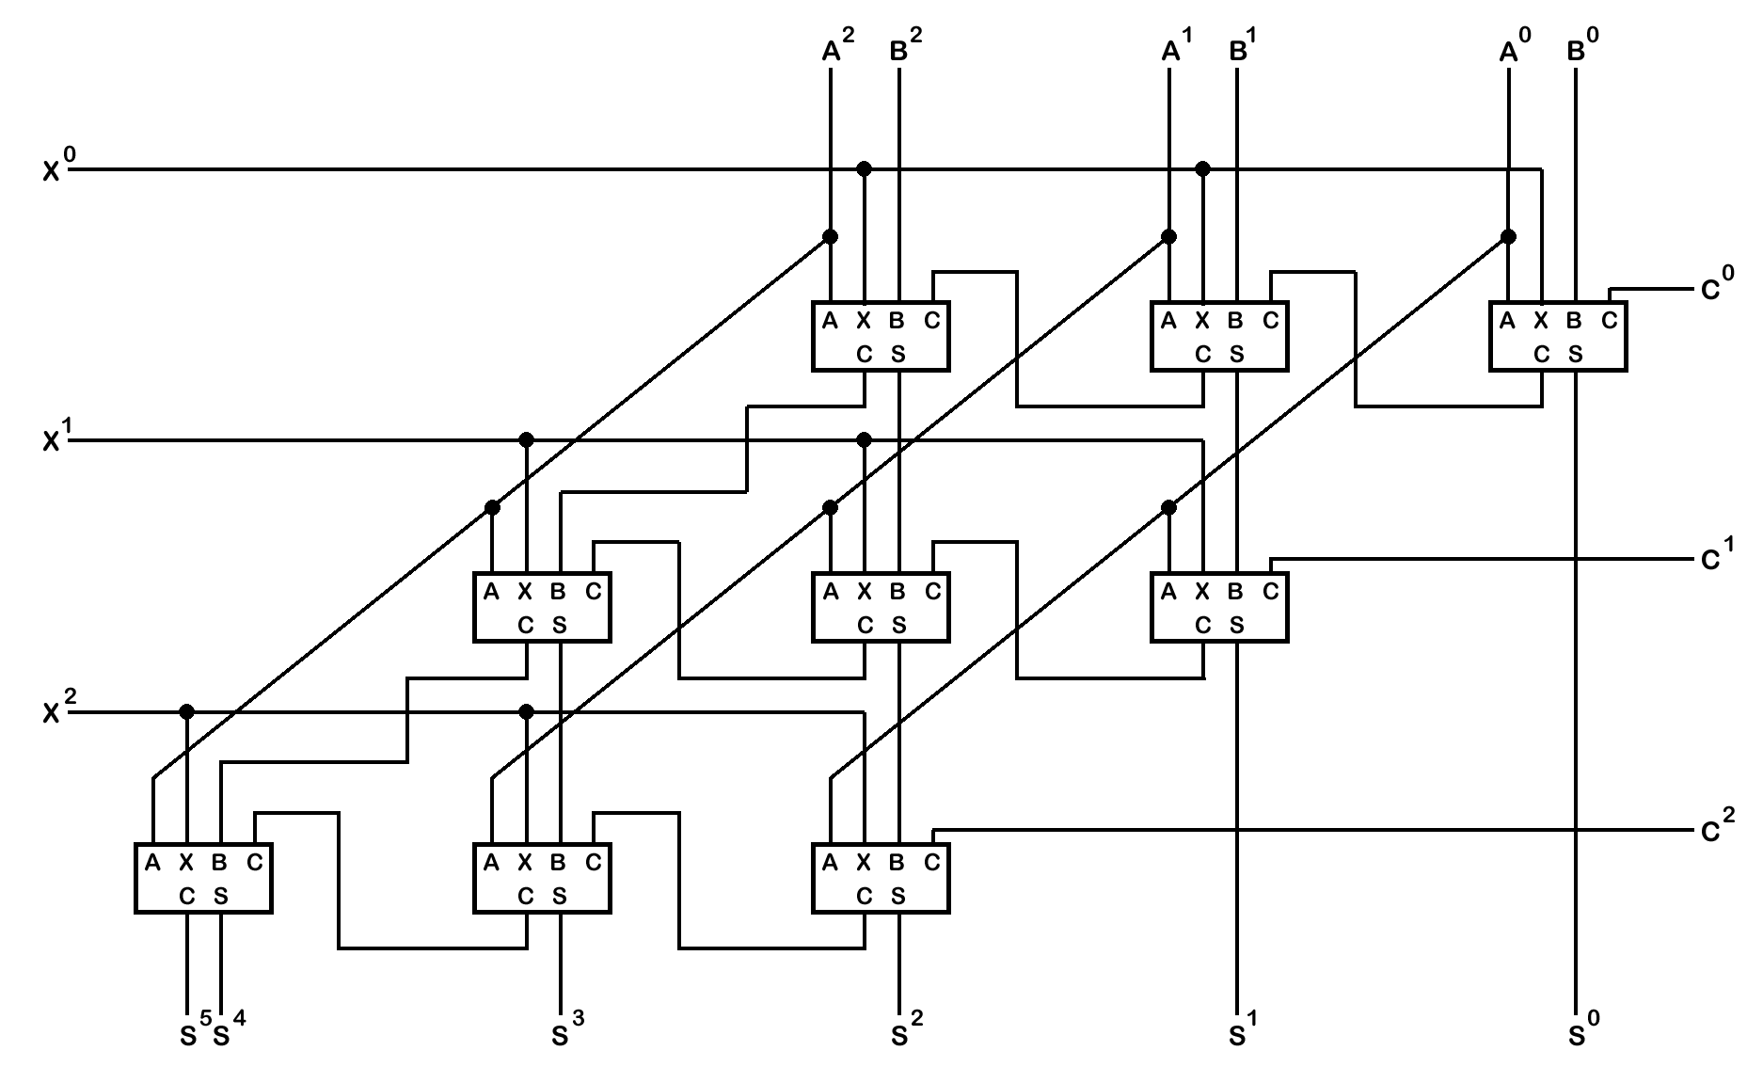

Slide 16
1 0 1 1 1 Multiplicand x 1 1 1 0 Multiplier 1 0 1 1 1 Multiplicand x 0 0 0 0 Multiplier 0 0 0 0 0 partial product 0 0 0 0 0 sum in 0 0 0 0 0 Carry (generated during addition) 0 0 0 0 0 sum out 1 0 1 1 1 Multiplicand x 0 0 1 0 Multiplier 1 0 1 1 1 partial product 0 0 0 0 0 sum in 0 0 0 0 0 0 Carry (generated during addition) 1 0 1 1 1 0 sum out 1 0 1 1 1 Multiplicand x 0 1 0 0 Multiplier 1 0 1 1 1 partial product 1 0 1 1 1 0 sum in 1 1 1 1 1 0 0 0 Carry (generated during addition) 1 0 0 0 1 0 1 0 sum out 1 0 1 1 1 Multiplicand x 1 0 0 0 Multiplier 1 0 1 1 1 partial product 1 0 0 0 1 0 1 0 sum in 1 0 1 1 1 0 0 0 0 Carry (generated during addition) 1 0 1 0 0 0 0 1 0 sum out

Slide 17
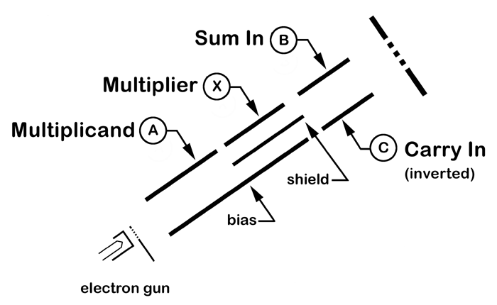
Cathode Ray Tube

Slide 18
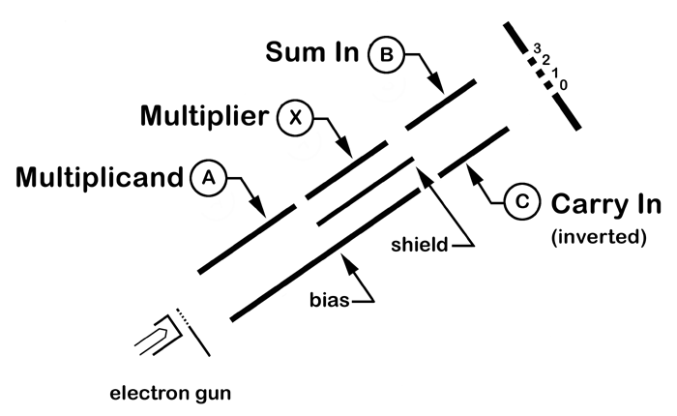
CRT… plus windows

Slide 19
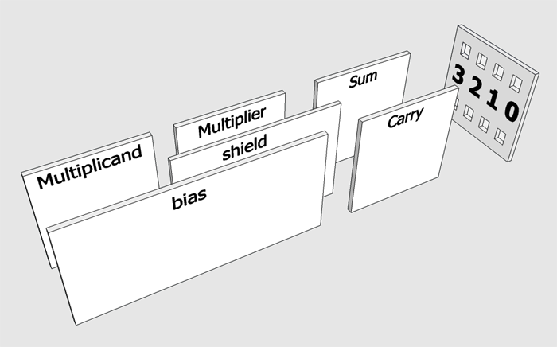
Three Bit CRT: AX+B+C

Slide 20
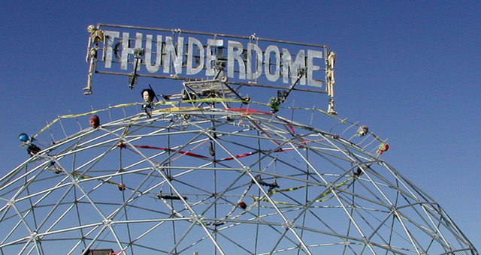
Secondary Electron Emission

Slide 21
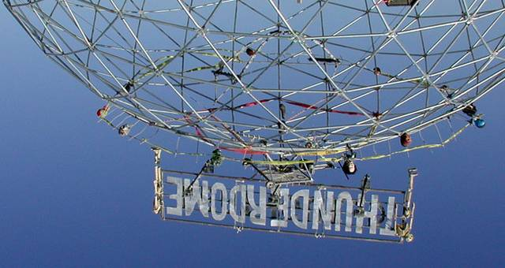
One man enters. Two men leave.

Slide 22
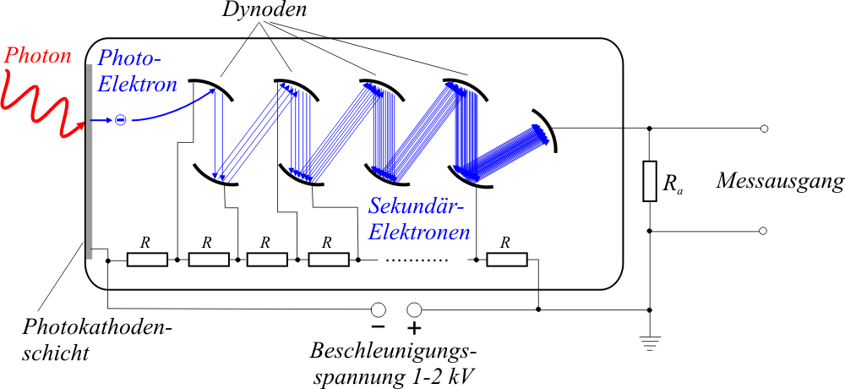

Slide 23
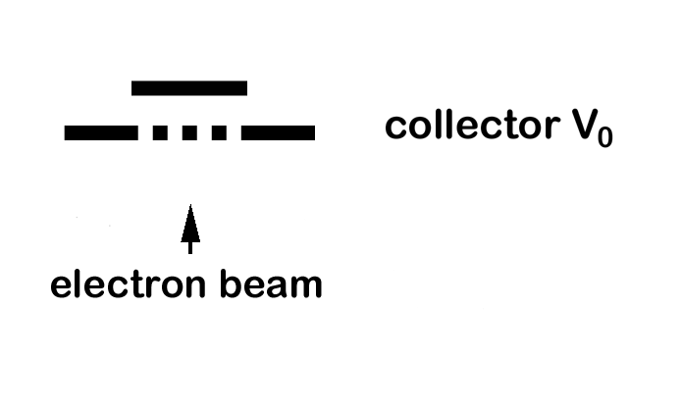
Floating Target

Slide 24
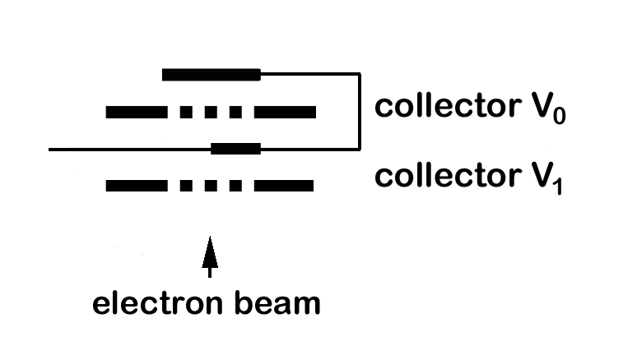
Floating Target

Slide 26
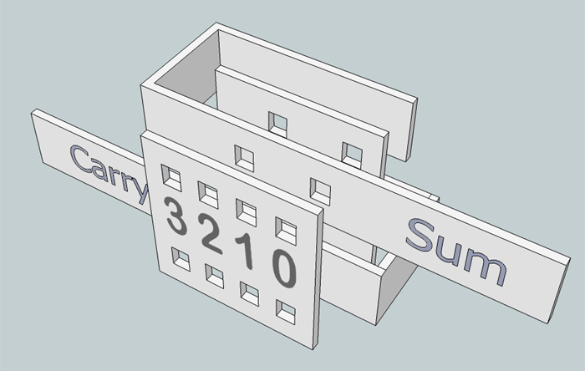
Target… now with labels!

Slide 27
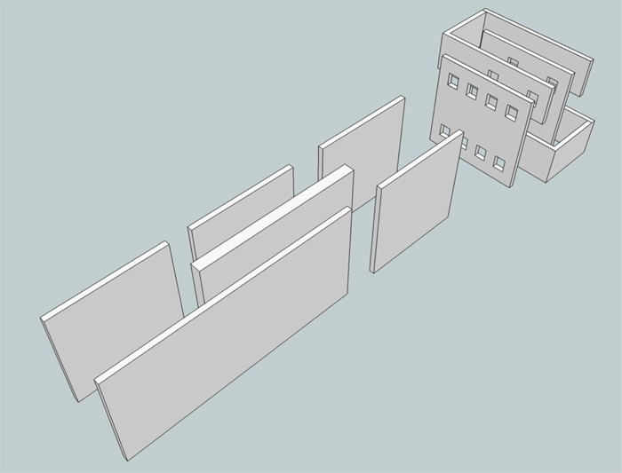
Inputs and Outputs

Slide 28
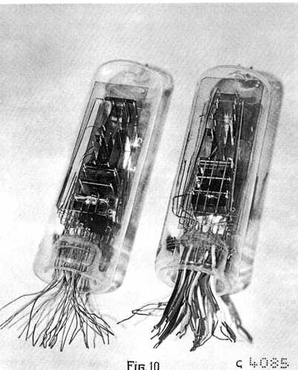

Slide 29
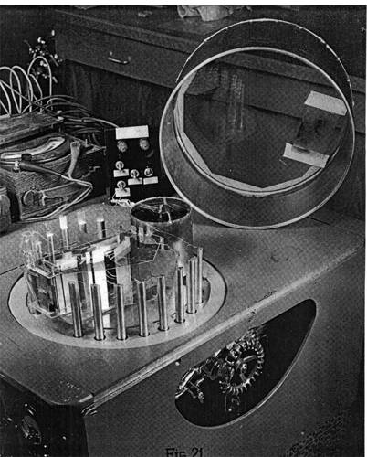

Slide 31
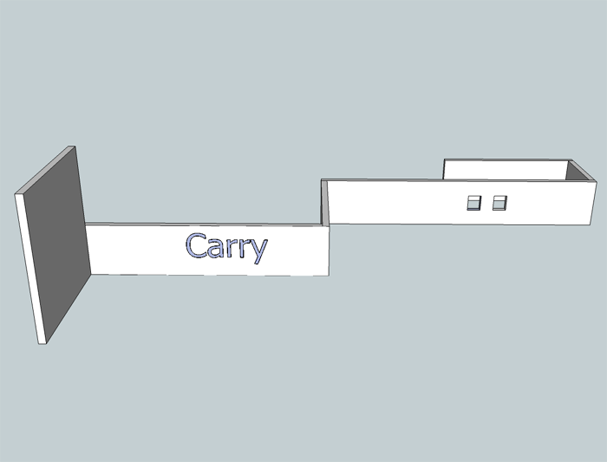

Slide 32
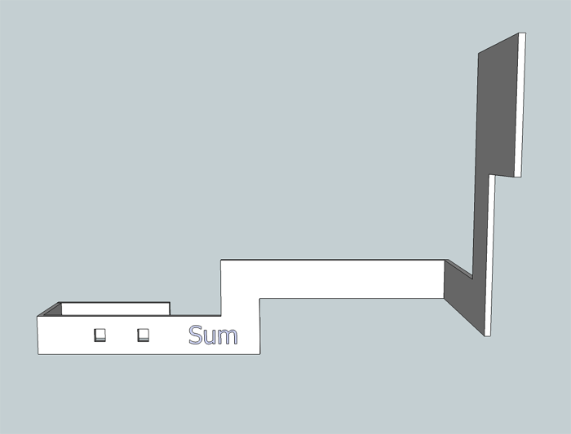

Slide 33
SketchUp
Step20

Slide 34
